Slide 1
Citi Bike Data Analysis
By Azhar Batyrgali

Slide 2
Citi Bike Data Analysis
By Azhar Batyrgali

Slide 3
Project Goal:
To better understand the behavior of Citi Bike’s customer base (both one-time users and subscribers) and how they use Citi Bikes
This will help us to:
  Identify where more bikes should be installed
  Create targeted marketing campaigns that will appeal to different customer segments

Slide 4
Key questions:
What are the most popular pick-up locations across the city for Citi Bike rental?
How does the average trip duration vary across different age groups?
Which age group rents the most bikes?
How does bike rental vary across the two user groups (one-time users vs long-term subscribers) on different days of the week?
Does the factor of user age impact the average bike trip duration?

Slide 5
Findings & Insights

Slide 6
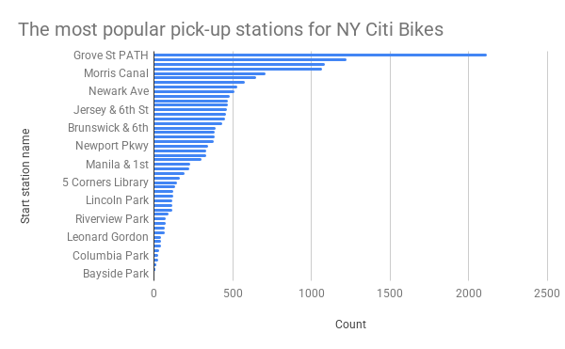
What are the most popular Citi Bike pick-up locations?

Slide 7
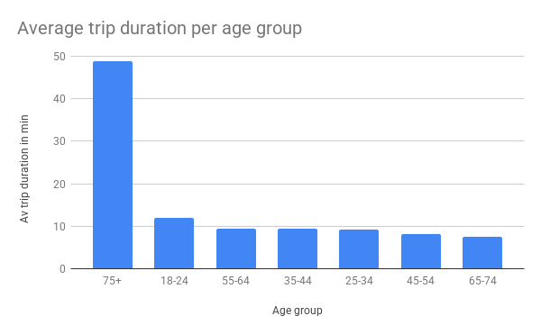
2. How does the average trip duration vary across different age groups?
Average trip duration varies by age, with older users generally taking longer rides. The 75+ age group has significantly higher average trip durations, while most working-age groups (25–64) show similar, shorter trips, indicating primarily utilitarian use.

Slide 8
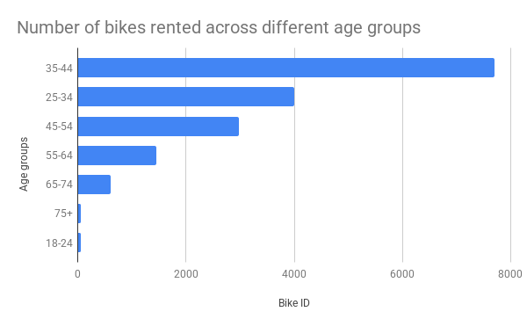
3. Which age group rents the most bikes?
Bike rentals are highest among the 35–44 age group, followed by users aged 25–34 and 45–54. This suggests that Citi Bike is predominantly used by working-age adults, likely for commuting and daily mobility.

Slide 9
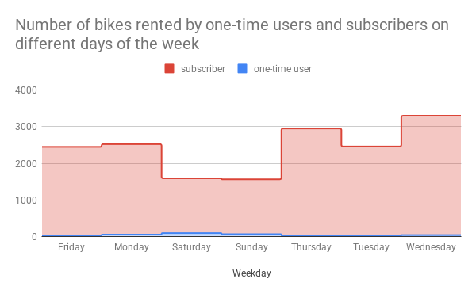
4. How does bike rental vary across the two user groups (one-time users vs long-term subscribers) on different days of the week?
Rental patterns differ clearly by user type and day of the week. Long-term subscribers dominate weekday usage, reflecting regular commuting behavior, whereas one-time users are more active on weekends, indicating leisure or tourist-driven demand.

Slide 10
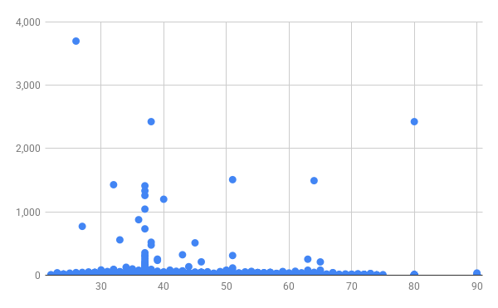
5. Do factors like weather and age impact the average bike trip duration?
Overall, factors like age (and indirectly weather) do not show a strong impact on average bike trip duration when looking at individual trip data. The scatter plot shows that most trips are short across all age groups, indicating no clear correlation between age and trip length. While the 75+ age group has a higher average trip duration when using mean values, the longest individual trips are actually taken by users aged 30–55. This difference arises because averages reflect overall tendencies, whereas the scatter plot highlights raw, individual trip behavior. Therefore, user age does not meaningfully predict trip duration at the individual level, making it a limited factor for this analysis.

Slide 11
Summary

Slide 12
Summary of findings:
Top 5 pick-up locations for bikes:
  Grove St Path, Exchange Place, Sip Ave, Hamilton Park, & Morris Canal
Customer base:
  Based on your findings, how would you describe Citi Bike’s customer base? Think in terms of characteristics like age and user type
Citi Bike customer behavior:
  Who takes the longest and shortest trips on average?

Slide 13
Actions & Recommendations

Slide 14
Recommended actions:
Product recommendations:
Install more bikes at Grove St PATH, Exchange Place, Sip Ave, Hamilton Park, Morris Canal, Newport PATH, City Hall, Van Vorst Park, Newark Ave, and Warren St.
Marketing recommendations:
The Citi Bike customer base is mostly long-term subscribers aged between 25 and 44, who are most active on weekdays. This tells us that they are probably people who live in New York and use Citi Bikes to commute. Marketing and advertising campaigns should therefore target this particular demographic.

Slide 15
Thank you!

Slide 16
Project Goal:
To better understand the behavior of Citi Bike’s customer base (both one-time users and subscribers) and how they use Citi Bikes
This will help us to:
  Identify where more bikes should be installed
  Create targeted marketing campaigns that will appeal to different customer segments

Slide 17
Key questions:
What are the most popular pick-up locations across the city for Citi Bike rental?
How does the average trip duration vary across different age groups?
Which age group rents the most bikes?
How does bike rental vary across the two user groups (one-time users vs long-term subscribers) on different days of the week?
Does the factor of user age impact the average bike trip duration?

Slide 18
Findings & Insights

Slide 19
What are the most popular Citi Bike pick-up locations?

Slide 20
2. How does the average trip duration vary across different age groups?
Average trip duration varies by age, with older users generally taking longer rides. The 75+ age group has significantly higher average trip durations, while most working-age groups (25–64) show similar, shorter trips, indicating primarily utilitarian use.

Slide 21
3. Which age group rents the most bikes?
Bike rentals are highest among the 35–44 age group, followed by users aged 25–34 and 45–54. This suggests that Citi Bike is predominantly used by working-age adults, likely for commuting and daily mobility.

Slide 22
4. How does bike rental vary across the two user groups (one-time users vs long-term subscribers) on different days of the week?
Rental patterns differ clearly by user type and day of the week. Long-term subscribers dominate weekday usage, reflecting regular commuting behavior, whereas one-time users are more active on weekends, indicating leisure or tourist-driven demand.

Slide 23
5. Do factors like weather and age impact the average bike trip duration?
Overall, factors like age (and indirectly weather) do not show a strong impact on average bike trip duration when looking at individual trip data. The scatter plot shows that most trips are short across all age groups, indicating no clear correlation between age and trip length. While the 75+ age group has a higher average trip duration when using mean values, the longest individual trips are actually taken by users aged 30–55. This difference arises because averages reflect overall tendencies, whereas the scatter plot highlights raw, individual trip behavior. Therefore, user age does not meaningfully predict trip duration at the individual level, making it a limited factor for this analysis.

Slide 24
Summary

Slide 25
Summary of findings:
Top 5 pick-up locations for bikes:
  Grove St Path, Exchange Place, Sip Ave, Hamilton Park, & Morris Canal
Customer base:
  Based on your findings, how would you describe Citi Bike’s customer base? Think in terms of characteristics like age and user type
Citi Bike customer behavior:
  Who takes the longest and shortest trips on average?

Slide 26
Actions & Recommendations

Slide 27
Recommended actions:
Product recommendations:
Install more bikes at Grove St PATH, Exchange Place, Sip Ave, Hamilton Park, Morris Canal, Newport PATH, City Hall, Van Vorst Park, Newark Ave, and Warren St.
Marketing recommendations:
The Citi Bike customer base is mostly long-term subscribers aged between 25 and 44, who are most active on weekdays. This tells us that they are probably people who live in New York and use Citi Bikes to commute. Marketing and advertising campaigns should therefore target this particular demographic.

Slide 28
Thank you!

